Slide 1



CAAFI 2014
General Meeting
& Expo
Mike Epstein
Research & Development Team
Produced by

Slide 2
Since the last General Meeting…
Off-year R&D Team workshop focusing on challenges and opportunities
Developed white papers
Developed position papers on R&D challenges and needs
Developed updated team Mission Statement
Established Seminars on Alternatives to Petroleum (Jet) – SOAP-Jet webinars

Slide 3
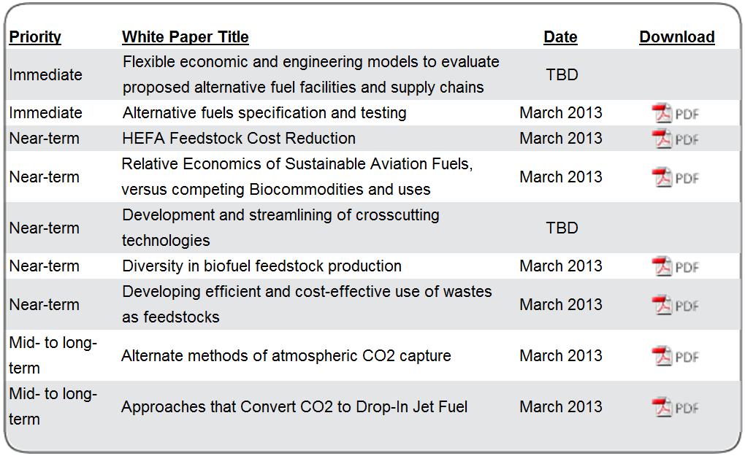
Critical R&D Challenges
Timeframe
Find chart at http://www.caafi.org/information/rdchallenges.html

Slide 4
SOAP-Jet Webinars
Intended to increase R&D team function as an information “node” for team members
First series focusing on DOE CHASE grant recipients
2 seminars held so far
70-ish attendees at each
Soliciting input on future topics from team

Slide 5
Breakout Discussion and Next Steps
White Papers
  Identified additional updates to add to existing papers
  Identified potential authors/contributors to desired topics
    Cross cutting technologies
    Flexible economic and engineering models
    Other papers suggested by team
Communications –
  Team to provide input on webinar topics
  Request for LinkedIn page and community
  Request to share resources and information via web links and discussion boards

Slide 6
Breakout Discussion and Next Steps
Feedstock Readiness Level (FSRL)
  Discussed utility of tool –identified utility for purchasers and USDA – helps to stack/rank projects
  Discussed potential for case studies via integration of FSRL as requirement for NIFA CAP grant reporting
    Provide case studies
    Provide expansion opportunity for residues/non-crop feedstocks
    Use as webinar topic

Slide 7
CAAFI 2014
General Meeting
& Expo
Mark Rumizen
Certification-Qualification Team
Produced by

Slide 8
CAAFI 2014
General Meeting
& Expo
Jim Hileman & Nancy Young
Environmental Team
Produced by

Slide 9

CAAFI Environment Team:
Developing Tools & Means to Address Environmental Issues
January 29, 2014
Subtitle
Nancy Young and Jim Hileman
Co-Leads of CAAFI Environment Team

Slide 10

Refresher on the Environmental Imperative
Overall Objectives for Alternative Fuel Deployment
  Energy Security/Supply Reliability
  Commodity Competitor to Petroleum
  Environmental Benefit (our focus)
Environmental Benefit
  Life Cycle Greenhouse Gas (GHG) Emissions Improvements
  Potential to Reduce Emissions with Air Quality Impact
  Sustainability More Broadly: Do Not Induce Other Environmental Problems
    Water use, land use, food-basket competition, etc.

Slide 11
Sustainability: Focus & Achievements to Date
Developed Sustainability “Impact Matrix” and Guidance
  Identified indicators (areas of concern) and relevant metrics for reflecting potential impact
  Overview of existing regulatory and voluntary sustainability regimes
  “Impact Matrix” defines the potential impact risk and metrics along the alternative fuel supply chain
Developed Environmental Progression
  Puts “environmental readiness” on a scale with feedstock readiness and fuel readiness

Slide 12



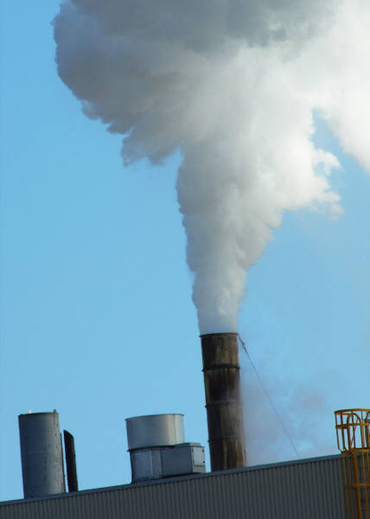




Capture Indicators
air quality
energy use
land use
GHG
water quality
biodiversity
soil quality
water use
Notes:
EP also focuses on the indicators we used in the sustainability doc –again, not exhaustive, but a sampling of those most of interest in the aviation community (GHGs, air quality, water use) & associated impacts (biodiversity, soil quality, land use)

Slide 13
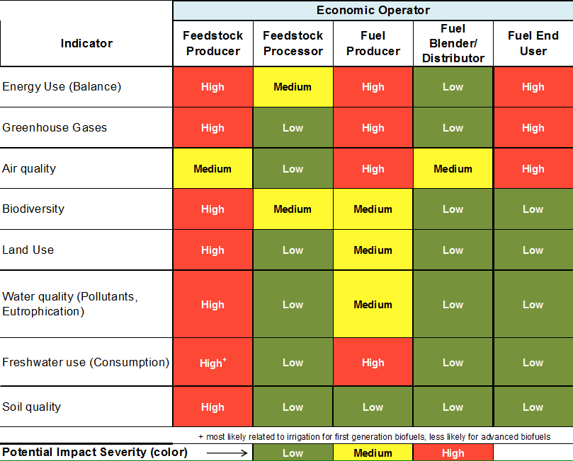
Impact Matrix
Assessing Potential for Environmental Impact
Notes:
Explain impact matrix—animate indicator circles (KCL – I’m debating whether we will have time to go through these in any detail – most likely will drop the animation because there won’t be time to go into them, but I’ll dry run it and see how it goes)
Develoepd to identify where environmental risks concentrate in supply chain. Started in the Env Team meeting in April of 2011. Fleshed out with help from Futurepast and LCA Associates and this team. the matrix does not say that the impacts ARE high, med or low, but that there is the potential for large impacts in some pieces of the supply chain. For example, clearly soil quality issues are more likely to occur in the feedstock production stage than, say the fuel blender. What we see is that the feedstock and fuel producer links of the chain are areas where risks need to be most closely scrutinized, & therefore in dealmaking, producers need to be prepared to demonstrate their environmental performance, mitigation, management, and purchasers need to ask about it.
It is important to note that this matrix is not exhaustive. There are pieces of the supply chain that are not addressed (e.g., transportaiton) but that does not mean that it isn’t important – we assume that some of those pieces not explicitly addressed here get folded into other units (eg.., harvesting/storage likely to be folded into feedstock production)

Slide 14
Motivation for
Environmental Progression
What environmental analyses might be expected and/or required for alternative jet fuel production?
When in pathway development can/should analyses be performed?
NOT prescriptive of outcomes (no thresholds)
Aligned Environmental Progression with Fuel Readiness Level and Feedstock Readiness Level
Notes:
Why did we develop the environmental progression? We had the FRL and were in the midst of developing the FSRL, both of which are gated processes for communicating about the technical development of a fuel and a feedstock. However, these tools only peripherally captured expectations about environmental analysis needs. Therefore, we identified a need to clarify and help map out what environmental analyses might be required and when one could actually perform as information is gathered. It is important to note that we are not prescribing a particular methodology or outcome in the Environmental Progression.

Slide 15
Environmental Progression
Environmental Progression | Risk Assessment | Risk Management
Basic Principles
Concept Formulated
Proof of Concept
Preliminary Technical Evaluation
Scale up Validation of Initial Assessments
Full-scale Feedstock Impact Evaluation
Full-scale Fuel Producer Impact Evaluation
Commercialization
Sustainable Feedstock and Fuel Supply Established
initial screening
Best management practices developed
estimates, rigorous study
permitting
reporting, continuous improvements
comprehensive analysis
Notes:
For the risk assessment side, the EP approach assumes that a producer will need to begin assesments of risk before there are a lot of data, and that therefore will nee dto refine most environmental analyses at every step of scale up as more data become available. A comprehensive analysis cannot really occur until a full-size, commercial facility is in place, but this does not mean there is no value in early stage assessments, as these can guide development to avoid actual impacts. On the risk management side, there is still a proactive element of developing management plans and identifying bmps, as well as planning for a rigorous enviornmental management system, but there is also a very concrete element relating to meeting regulatory requirements, standards, and acquiring environmental permits that can help manage risks associated with developing out a new process or pathway.

Slide 16
GHG Life Cycle Analysis:
Focus & Achievements to Date
Confirmed We Know the Steps and How to Apply Them to Aviation (building on “Framework & Guidance for Estimating Greenhouse Gas Footprints of Aviation Fuels”)
Integrated Jet Fuel into the Argonne National Labs’ GREET Model
Initial comparison of LC GHG results using different tools and under different regulations

Slide 17
Focus on Continued & Verifiable Aviation GHG Emissions Improvement
Industry Commitments to CO2 reduction
State-Specific & Regional Initiatives
  e.g., FAA goal for carbon neutral growth
  e.g., European Union Emissions Trading Scheme
  e.g., U.S. requirement for federal/military procurement of fuels
    Can only procure alternative fuels with lifecycle emissions better than or equal to conventional fuels (EISA Section 526)
States Are Working on a Global Agreement for Addressing Aviation GHG Emissions through the International Civil Aviation Organization (ICAO)
  Includes carbon neutral growth from 2020 goal
  ICAO CAEP Alternative Fuels Task Force
  Working on a potential global market-based measure

Slide 18
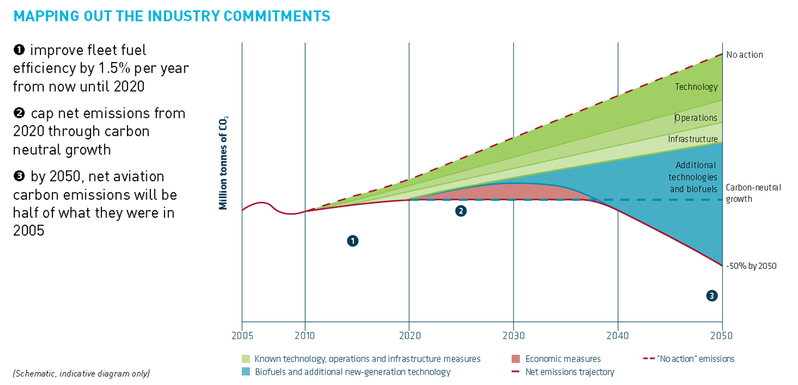
How Do We Meet Our Targets?
Technology, Alt Fuels, Operations & Infrastructure
Source: Air Transport Action Group (ATAG) “A sustainable flightpath towards reducing emissions” (2012). http://atag.org/component/downloads/downloads/203.html

Slide 19
Aviation Has a Unique Need for Future Acceptance of GHG LCA Results Across Borders
Obviously, Aircraft Are Mobile Sources that Cross Borders
System of CO2 Monitoring, Reporting & Verification needed for Global Aviation CO2 Programs
GHG LCA Results Will be a Key Part of any Global Scheme
Need Means for “Mutual Recognition” Among States and Perhaps, Ultimately, Harmonization
Key Starting Point: Understand the Differences Between LCA Regulatory Approaches and Tools

Slide 20
Jan 2014 Environment Team Workshop
Goal and Process
Examine variations in life cycle greenhouse gas (GHG) emissions due to:
  Using different Life Cycle Analysis (LCA) methods, tools, and data
  Meeting varied purposes and regulatory regimes
    Goal:
  Identify elements that lead to variations in LC GHG emissions results
  Develop actions that could be taken to improve our understanding
Process:
  Briefings explored how life cycle GHG emissions varied with different tools and purposes
  Group discussion led to creation of an LCA Issue Matrix spreadsheet (that is still under development)

Slide 21
Jan 2014 Environment Team Workshop
LCA Issue Matrix

Slide 22
Jan 2014 Environment Team Workshop
LCA Issue Matrix
“Elements” that could lead to variations in LC GHG emissions results
Workshop focused
on identifying these “elements” (preliminary list shown here)

Slide 23
Jan 2014 Environment Team Workshop
LCA Issue Matrix
Feedstock-to-Fuel Pathways

Slide 24
Jan 2014 Environment Team Workshop
LCA Issue Matrix
Questions of Interest:
Does the "element" contribute to differences in LC GHG emissions results for this "fuel pathway"?
Does the "element" impact a "fuel pathway's" qualification under a reduced LC GHG emissions policy (e.g., RFS2)?
Following workshop input, we will refine questions to better reflect different purposes for conducting life cycle GHG analysis

Slide 25
Jan 2014 Environment Team Workshop
LCA Issue Matrix
Seeking answer to each Question for each Element and Fuel Pathway
YES | MAYBE | NO

Slide 26
Jan 2014 Environment Team Workshop
LCA Issue Matrix
Will use
YES | MAYBE | NO answers to identify and prioritize elements that lead to variations in LC GHG emissions results

Slide 27
Jan 2014 Environment Team Workshop
“Element” Categories
Workshop discussion focused on four categories of “elements” that could lead to LC GHG variation:
Baseline for Comparison / What is the Question you are Answering?
Data sources
Allocation
System Boundary (in a loose sense, this is a question of attributional versus consequential analysis)

Slide 28
Ongoing Work
Sustainability guidance and impact matrix are living documents and we continue to seek input on how to improve their utility
Complete LCA Impact Matrix and solicit input from experts to answer the questions such that we create a prioritized list of “elements” to be addressed
Conduct a 1.5 day CAAFI Environment Team meeting in early 2015

Slide 30
CAAFI 2014
General Meeting
& Expo
John Heimlich
Business Team
Produced by

